Slide 1
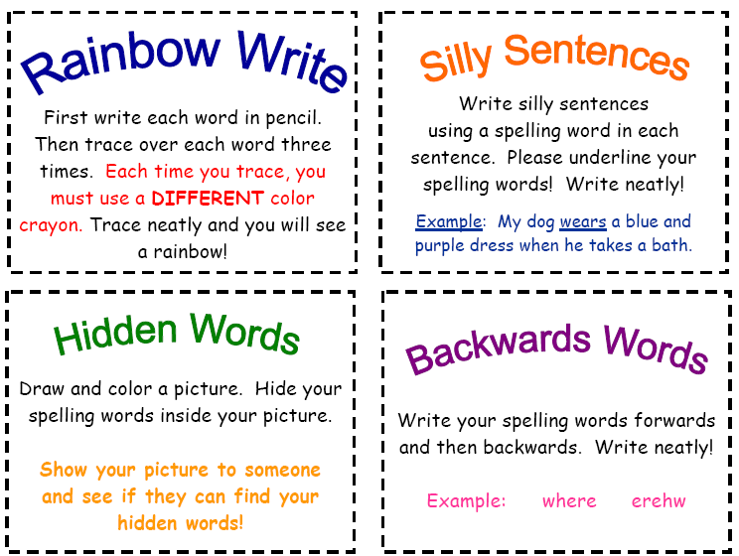
Notes:
http://www.teacherweb.com/VA/ThurgoodMarshallElementarySchool/MrsStamp/

Slide 2
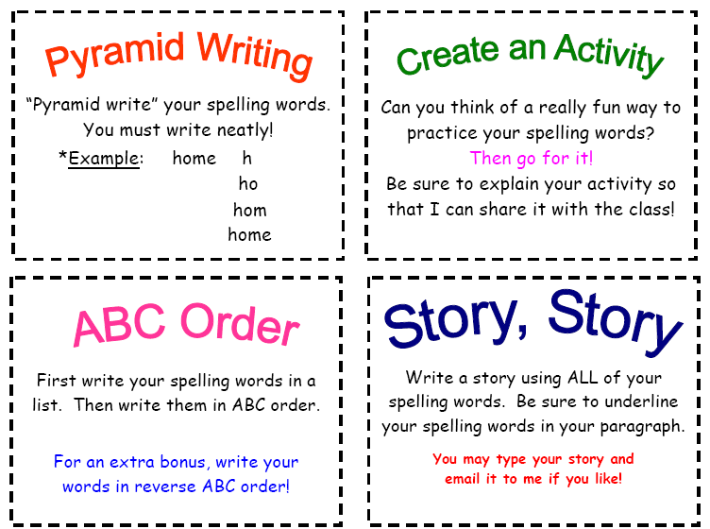
First make 3 columns on your paper. In the 1st one write your spelling words in a list. In the 2nd write them in ABC order and in the 3rd write them in reverse ABC order.

Slide 3
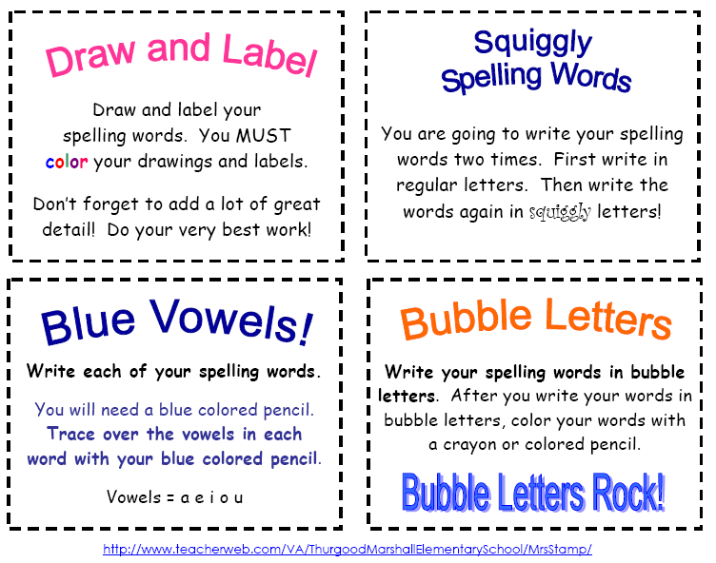

Slide 4
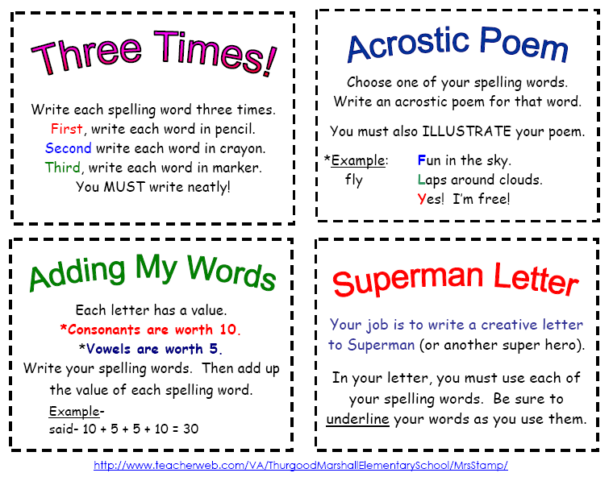

Slide 5
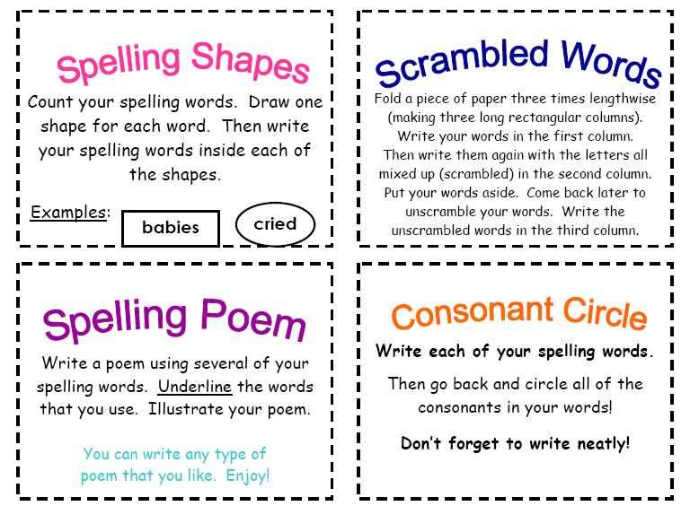

Slide 6
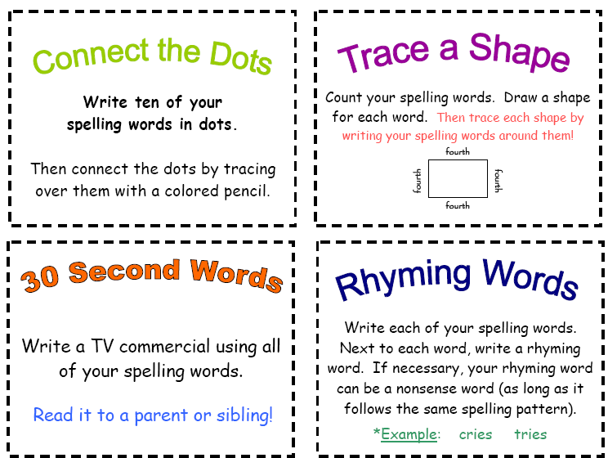
Buy…Act Now!!!
Write a TV Commercial or Newspaper Ad using all of your spelling words.

Slide 7
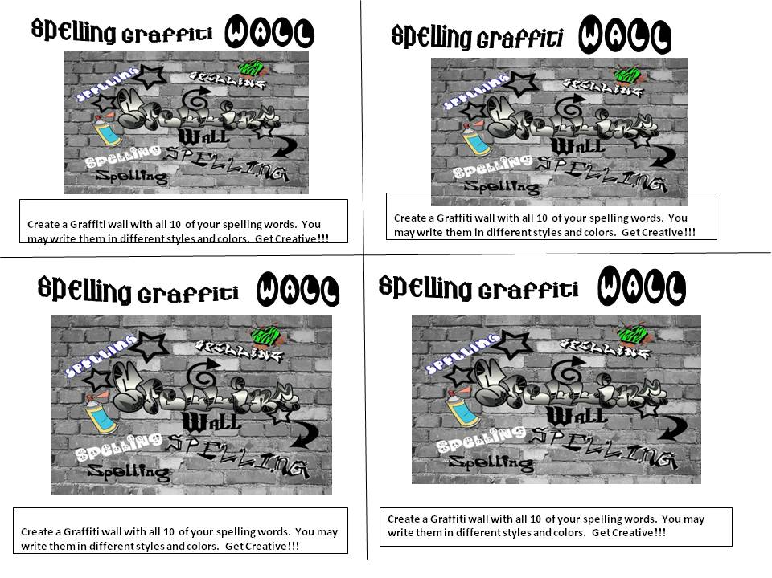

Slide 8
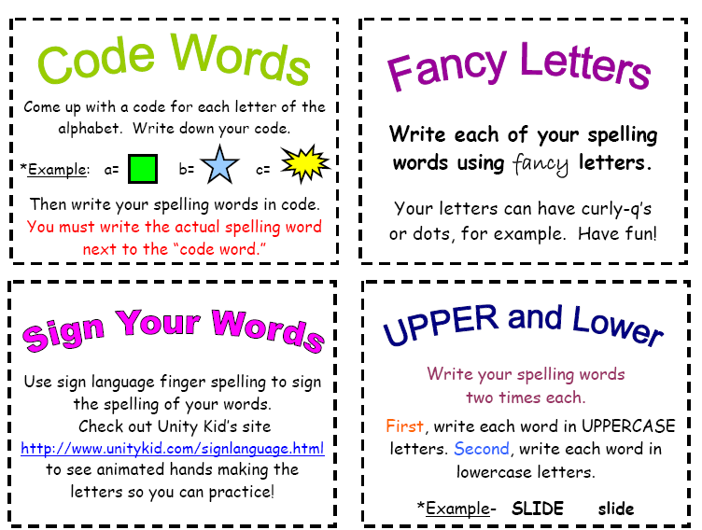

Slide 9



Make a list of your spelling words. Then get a newspaper and for each spelling word highlight a word that has the same weekly focus sound and spelling. Write it next to the spelling word it matches.
Word
Scavenger Hunt
Tic
Toe
Tac
On a blank sheet of paper make a Tic Tac Toe board. Write a spelling word in every square. Make a flash card for each word. Find someone to play with. Shuffle the cards. Take turns drawing a card. Read & spell your word out loud. Then, put your X or O in that square. 1st three in a row wins. Have your partner sign & turn in board.
Crossword Key
Word Search
Get a crossword grid from the teacher. Start with two of your spelling words that have a letter in common and decide how to “cross” them by writing one vertical and one horizontal, so the words share a letter where they intersect. Continue adding spelling words. Then create your clues. For bonus pts create a blank version of your crossword and challenge someone (family or friend). Have them sign it once finished and turn in with your key.
Create your own word search. Get a word sear grid from the teacher. First, make a search list at the bottom. Next start writing your spelling words diagonally, horizontally, and vertically. Then, fill in all leftover boxes with random letters. For bonus points have someone complete and sign your word search before turning in.

Slide 10
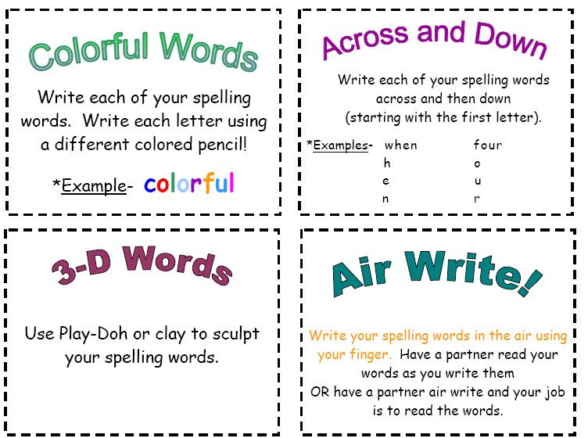

SUPER SENTENCES
Write 8 to 10 sentences, using each spelling word and plenty of big rich verbs and adjectives. First, think of just a simple sentence, and then transform it into a SUPERSENTENCE!
You may use your thesauruses.
Ex. The guy stole the diamond. Turns into-- The undoubtedly suspicious male was the thief of the remarkably stunning precious gemstone.

Slide 11
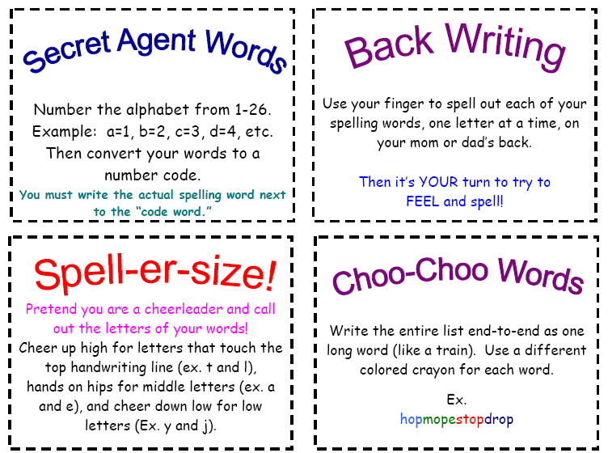
Have Mom or Dad Sign your paper

Slide 12
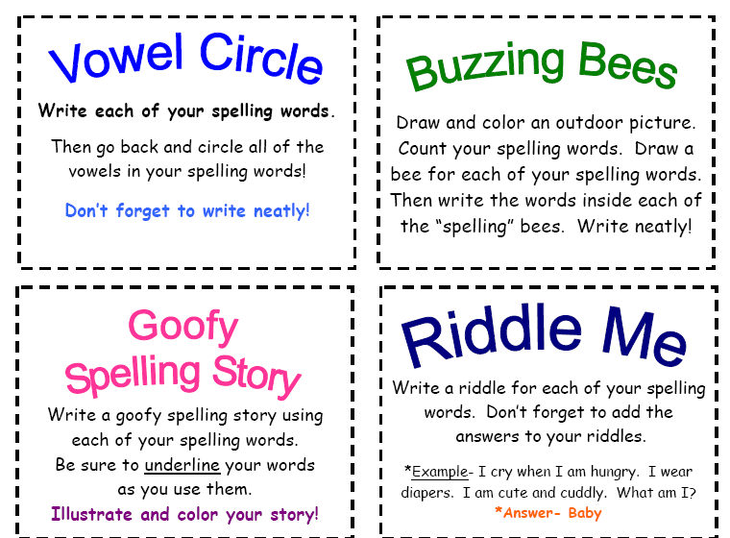

Slide 13
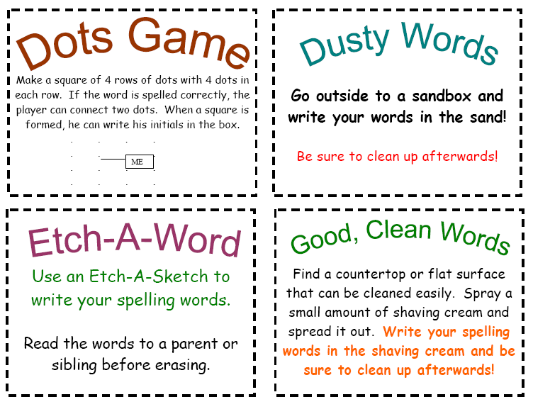

Slide 14
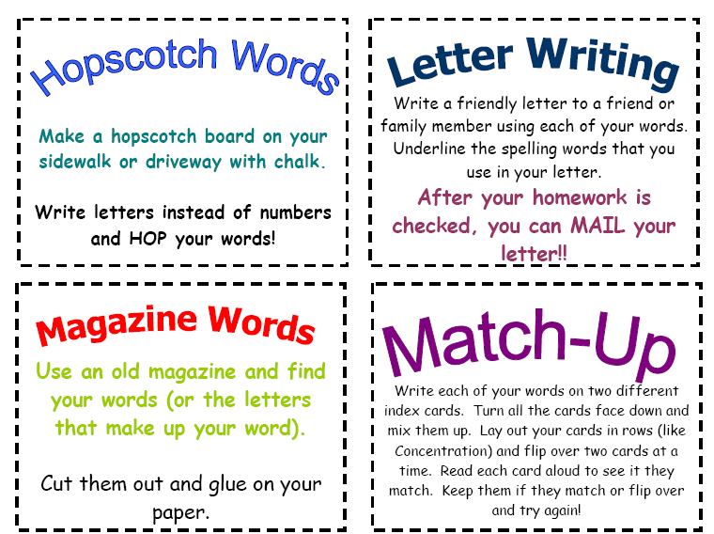

Slide 15
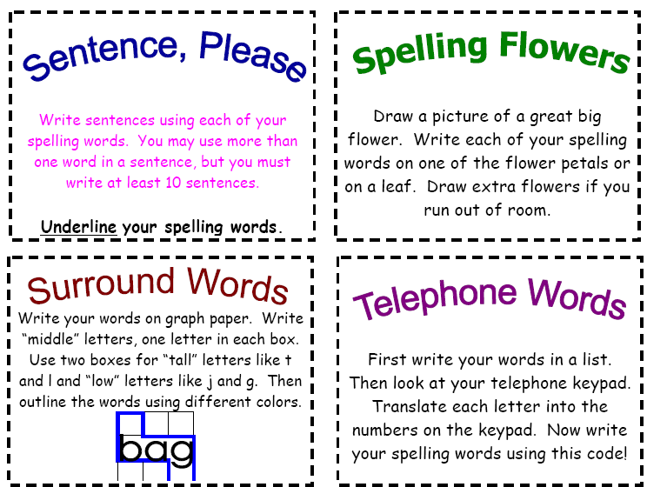

Slide 16
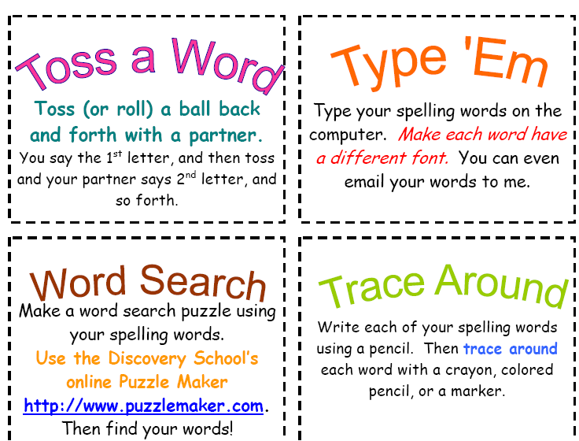

Slide 17
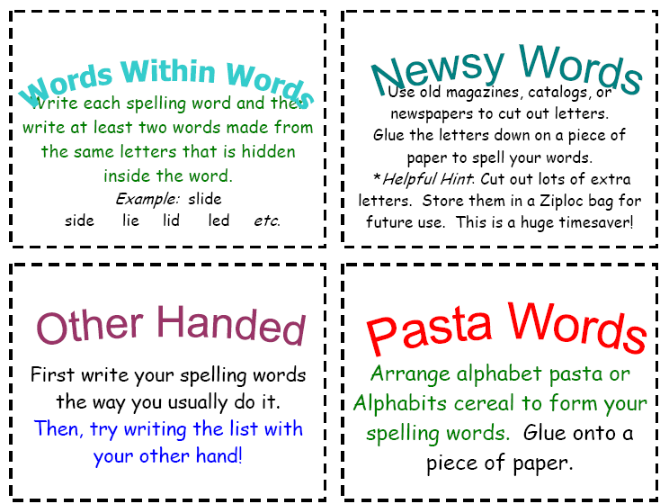

Slide 18
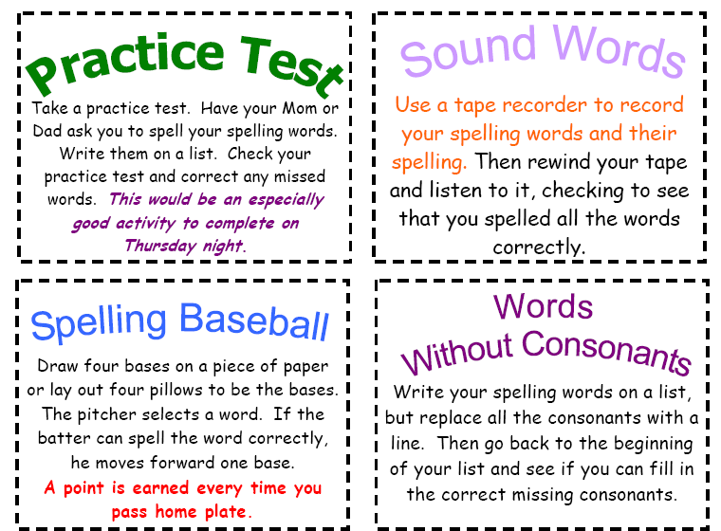

Slide 19
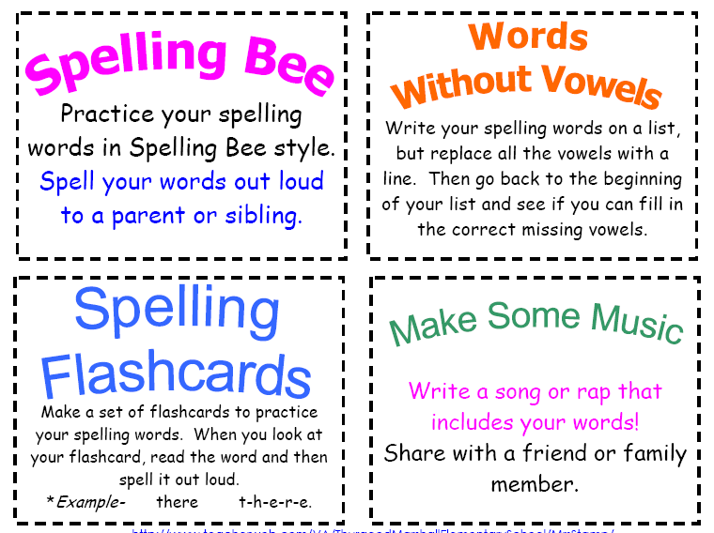

Slide 20
